Slide 2
AWARD
2-5/04/2024

Slide 3
Presentation of the project
AWARD has received funding from the European Union’s Horizon 2020 research and innovation program under Grant Agreement No 101006817
The content of this presentation reflects only the author’s view. Neither the European Commission nor the CINEA is responsible for any use that may be made of the information it contains.

Slide 4
AWARD overview
H2020 framework​
2018-2020 : Digitising and Transforming European Industry and Services: Automated Road Transport​
DT-ART-05-2020 : Efficient and safe connected and automated heavy-duty vehicles in real logistics operations
AWARD : All Weather Autonomous Real logistics operations and Demonstrations
Project Coordinator : EasyMile
Budget : € 26M
Partners : 29
Notes:
H2020 framework: H2020 is Horizon 2020, which is the European Union's research and innovation program aimed to drive economic growth and create jobs by investing in breakthrough innovations. It supports various research and innovation projects across different sectors, including science, societal challenges, and technology.
So these forward-thinking people at the European Union saw a gap in the application of a particular type of technology for heavy-duty logistics. There had been (and still is) a lot of noise about autonomous shuttles, robotaxis, driverless cars..... But that's all been going a little slower than we all thought. But at the same time we were really mastering the technology and application of these. So what better place to use it than on another set of niche, heavy vehicles, addressing a real challenge that they have in operating conditions..... Can anyone guess? When we see a very cloudy sky... etc. So that leads me to the name of the project:
AWARD
… And there is a blue-chip list of partners attached to this. We've got heavy-duty vehicle manufacturers, tier 1 and 2 technology providers, end-users, and logistics operators from factories, warehouses, ports, and airports, as well as labs and regulation entities.
I hope you'll see the maturity and mix in this cooperation between leading companies and innovative, growing ones – all recognized for their real-world applications and expertize, as well as research organisations. All helping toward the replicability and sustainability of project results.

Slide 5
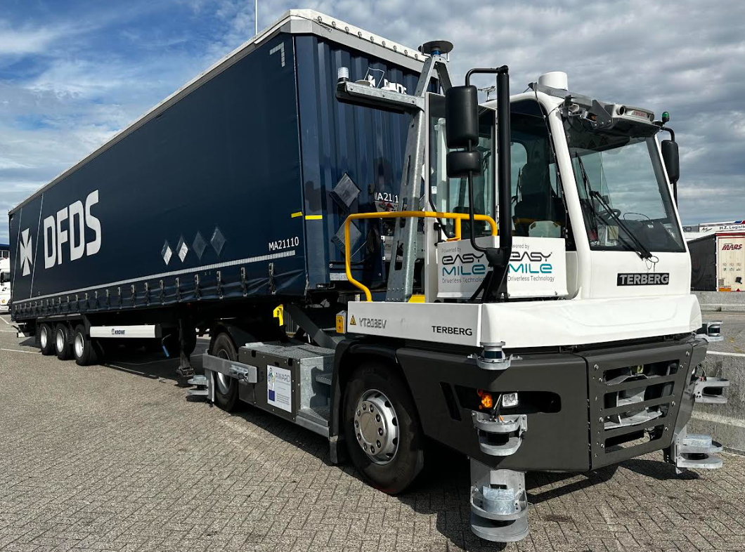
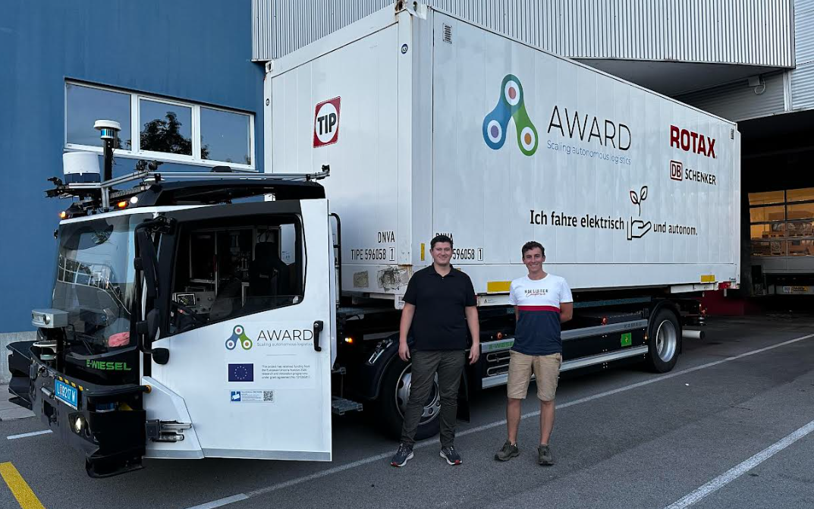
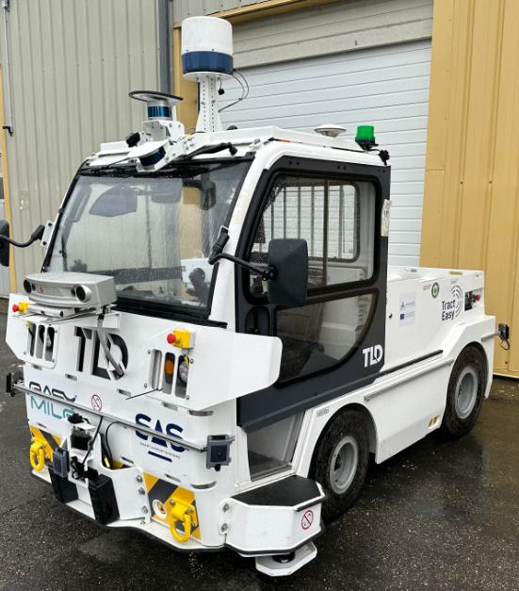
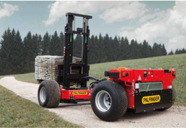
Four real-condition demonstrations
Harnessing the expertize of all consortium members
Development of the system
Integration into HDV and validation
Demonstrations
Able to handle adverse environmental conditions
Targeting compliance with ISO 26262 and taking into consideration SOTIF recommendations
Integrating an embedded teleoperation system to address 24/7 availability and multiple sensor modalities:
Optimized fleet management & supervision system for logistics use cases
Port Trailer autonomous transfer operations
Hub to hub autonomous logistics on public roads
Airport autonomous ground support equipment
Autonomous loading and unloading operations
Notes:
Development and integration of the system with sensors providers (CONTINENTAL, FORESIGHT, ADASKY, NAVTECH, OTTOPIA) and OEM (TERBERG, KAMAG, TLD)
Validation in EM test site + in DIGITRANS Austria to run scenarios close to logistics operations under rain conditions
Real condition demonstration in Airport (AVINOR), Port (DFDS), Hub to Hub (ROTAX – DB SCHENKER), Aritrary area (AIT)

Slide 6
2. Project progress
AWARD has received funding from the European Union’s Horizon 2020 research and innovation program under Grant Agreement No 101006817
The content of this presentation reflects only the author’s view. Neither the European Commission nor the CINEA is responsible for any use that may be made of the information it contains.

Slide 7
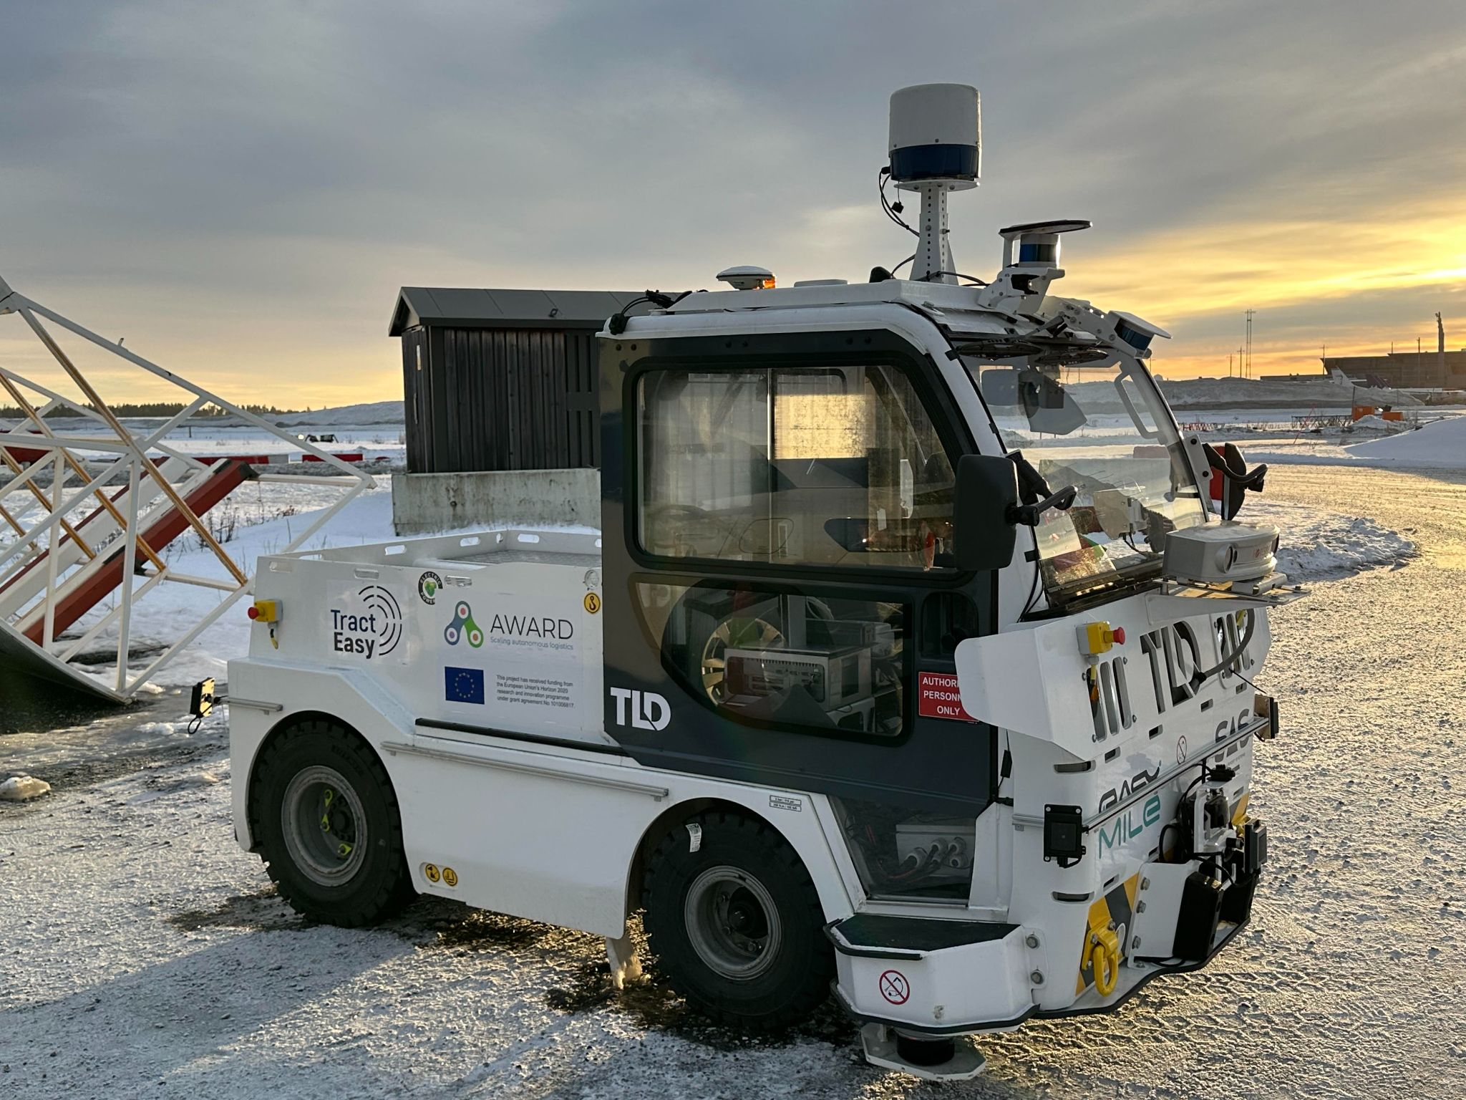
On the tarmac
Real-condition operations with AVINOR at Oslo Airport, Norway
Airport conditions simulation in test track
10 scenarios tested (passable objects, vehicle overtaken, intersection, etc.)
Different obstacles: car, pedestrian, barriers, suitcase
Simulation of rain until 100mm/h
Trailers management in the airport
Operations in snow condition done, datas under analysis
Notes:
3 phases:
Test on the Oslo airport playground and validation with the end user (AVINOR): last year
New mission (the one described on the slide) with safety driver (AVINOR): last winter
Same mission w/o safety driver with a safety car following the vehicle (this winter)

Slide 8
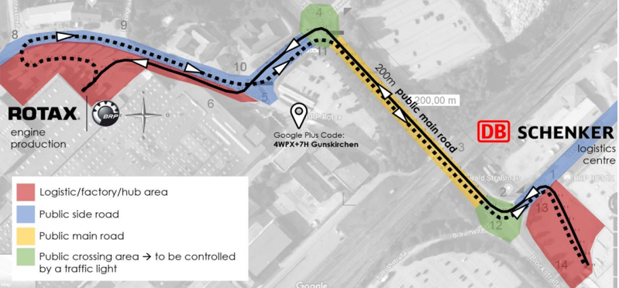
On the road
Hub-to-hub with ROTAX and DB SCHENKER in Gunskirchen, Austria
Logistics maneuvers simulation in test track
8 scenarios tested (passable objects, vehicle overtaken, running backwards, etc.)
Different obstacles: car, pedestrian, barriers, pallets
Simulation of rain until 100mm/h
Swap body container displacement from point A to B and B to A driving through public road equipped with traffic lights (V2I)
Route described above in auto mode with different levels of mixed traffic management (none, low, normal) at 20kph
2 months of operations, successful under normal and rainy conditions
Notes:
Route:
-continous path: from DB SCHENKER to ROTAX
-Stippling path: from ROTAX to DB SCHENKER
-red areas are closed
-blue and Yellow public roads
-green: intersections equipped with traffic lights that communicates with vehicle (C-ITS)

Slide 9
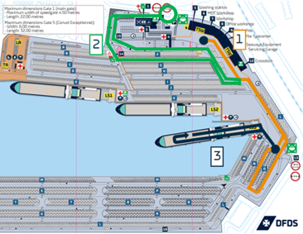
At the port
Real-condition scenarios with DFDS in Vlaardingen, The Netherlands
Usual port situations simulation in test track
9 scenarios tested (passable objects, vehicle overtaken, roundabout, etc.)
Different obstacles: car, pedestrian, barriers, pallets
Simulation of rain until 100mm/h
Trailer management in the port
3 phases: trailer management in the port (1), going in and out the site to communicate with barriers system (2), trailer management in a vessel (3)
Operations finished, under analysis
Notes:
Management of a trailer on site such as the thermal Tug manually used by site owner
Interaction with gate to simulate entrance and exit of the site autonomously
Enter the vessel + do a u-turn + exit the vessel autonomously

Slide 10
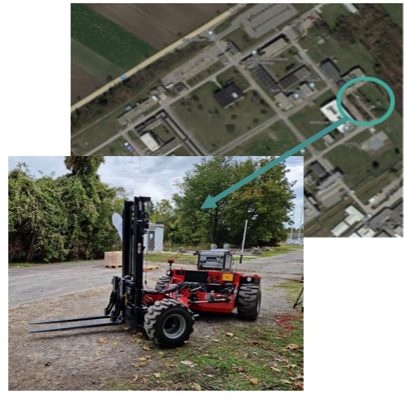
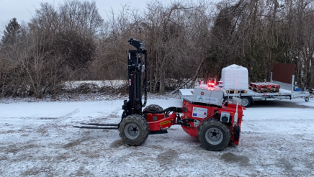
On-site
Demonstration of autonomous truck loading
Pallets management in arbitrary area
Mission: load and unload pallets on a truck in arbitrary area
Tests on going (Final Demonstration on May, Seibersdorf (Austria)

Slide 11
AWARD 2nd Final Conference

Slide 12
AWARD Survey #4: Automated vehicles in logistics operations

Slide 13
Thank you!
AWARD has received funding from the European Union’s Horizon 2020 research and innovation program under Grant Agreement No 101006817
The content of this presentation reflects only the author’s view. Neither the European Commission nor the CINEA is responsible for any use that may be made of the information it contains.

Slide 14
AWARD © - H2020 - Confidential, 2021
This project has received funding from the European Union’s Horizon 2020 research and innovation programme under Grant Agreement No. 101006817. The content of this presentation reflects only the author’s view. Neither the European Commission nor the CINEA is responsible for any use that may be made of the information it contains.

