Slide 2
Contents
Introduction to AWARD Project
Project aim and characteristics
Project timings and current state
Pilots’ description
Sustainability aspects of AWARD

Slide 3
Introduction to AWARD project
Project title: AWARD : All Weather Autonomous Real logistics operations and Demonstrations
Call for proposals: H2020-DT-ART-2018-2019-2020
Topic: DT-ART-05-2020
Project Coordinator : EasyMile
Budget : € 26M
Partners : 29
AWARD © - H2020 - Confidential, 2023
This project has received funding from the European Union’s Horizon 2020 research and innovation programme under Grant Agreement No. 101006817. The content of this presentation reflects only the author’s view. Neither the European Commission nor the INEA is responsible for any use that may be made of the information it contains.

Slide 4
Project aim and characteristics
Aim:
to pave the way for the roll-out of driverless transportation in a wide variety of applications and thus addressing driver shortage and capacity utilization, whatever the weather conditions are.
Characteristics:
4 pilots
ADS (Autonomous Driving System) to handle adverse weather conditions
Multimodal sensor set
Optimized fleet and supervision system
Technology used to detect data: radar, GNSS/RTK, LIDAR, stereo and thermal cameras
System's adaptability, scalability, and compliance with safety standards
AWARD © - H2020 - Confidential, 2023
This project has received funding from the European Union’s Horizon 2020 research and innovation programme under Grant Agreement No. 101006817. The content of this presentation reflects only the author’s view. Neither the European Commission nor the INEA is responsible for any use that may be made of the information it contains.

Slide 5
Project timings and current state
1 Jan 2021: Start Date
December 2023: Port use case: Scenarios tested. Operations completed. Data under analysis.
January 2024: Airport use case: scenarios tested. Operations completed. Data under analysis.
March 2024: Hub to Hub use case: scenarios tested. Currently in operation.
March 2024: On site truck loading use case: Tests ongoing.
13 June 2024: Final Event (Bruxelles)
30 June 2024: End date
Current state
Current state
AWARD © - H2020 - Confidential, 2023
This project has received funding from the European Union’s Horizon 2020 research and innovation programme under Grant Agreement No. 101006817. The content of this presentation reflects only the author’s view. Neither the European Commission nor the INEA is responsible for any use that may be made of the information it contains.

Slide 6
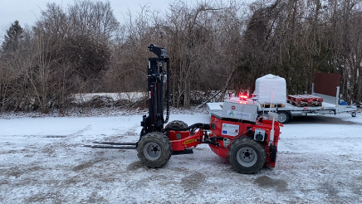
Pilot description: Use Case 1
Autonomous loading & unloading forklift operations. Demonstration of an autonomous counterbalanced forklift truck for logistics operations within factories, in Linde Aschaffenburg Material Handling (Germany).
Pallets management in arbitrary area
Mission: load and unload pallets on a truck in arbitrary area
Tests on going
AWARD © - H2020 - Confidential, 2023
This project has received funding from the European Union’s Horizon 2020 research and innovation programme under Grant Agreement No. 101006817. The content of this presentation reflects only the author’s view. Neither the European Commission nor the INEA is responsible for any use that may be made of the information it contains.

Slide 7
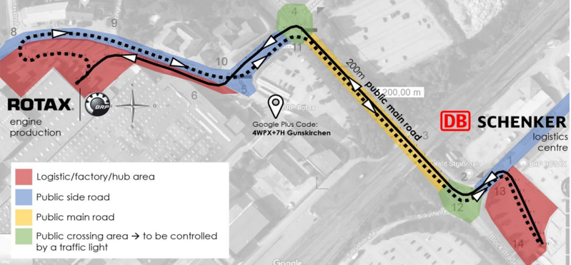
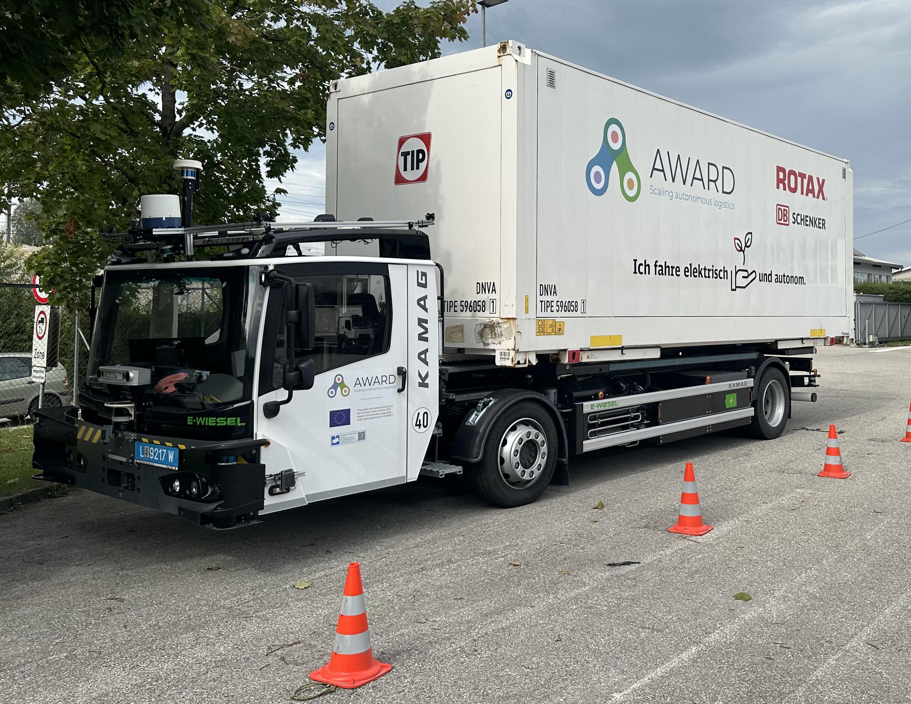
Pilot description: Use Case 2
Hub-to-hub autonomous logistics. Demonstration of an autonomous swap body truck between the Engine Factory of BRP-Rotax and the Logistic Hub of DB Schenker (Gunskirchen, Austria), which are connected via factory areas, public side roads, public main roads and public crossing areas.
Logistics maneuvers simulation in test track
8 scenarios tested (passable objects, vehicle overtaken, running backwards, etc.)
Different obstacles: car, pedestrian, barriers, pallets
Simulation of rain until 100mm/h
AWARD © - H2020 - Confidential, 2023
This project has received funding from the European Union’s Horizon 2020 research and innovation programme under Grant Agreement No. 101006817. The content of this presentation reflects only the author’s view. Neither the European Commission nor the INEA is responsible for any use that may be made of the information it contains.

Slide 8
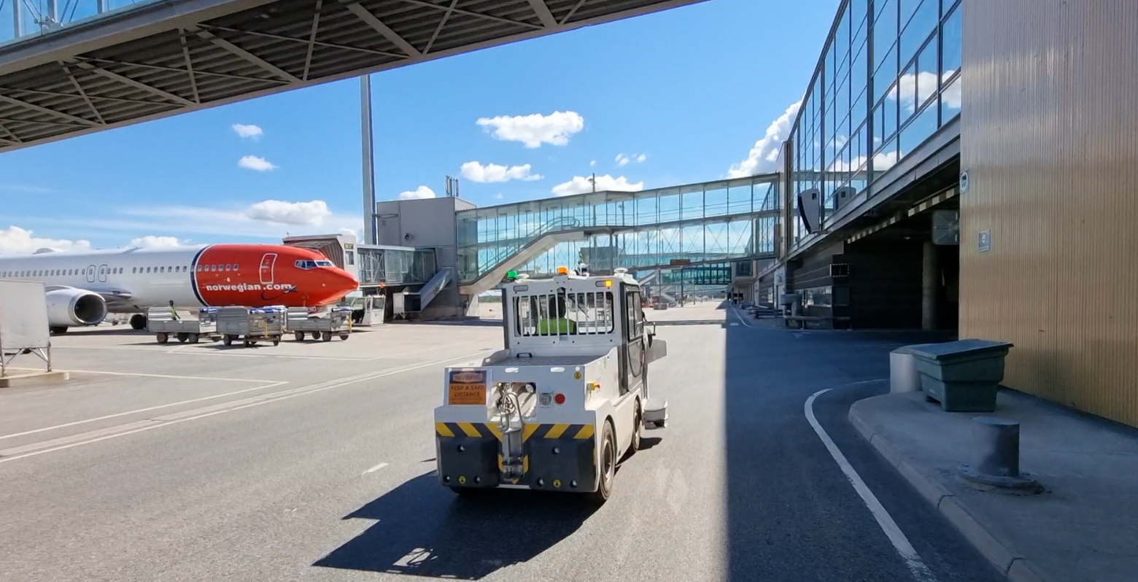
Pilot description: Use Case 3
Automous ground support equipment in airport. Demonstration of an autonomous baggage tractor on airside in Avinor OSL Gardermoen airport (Norway). It will allow real-life logistics operation with mixed traffic segment between warehouses.
Airport conditions simulation in test track
10 scenarios tested (passable objects, vehicle overtaken, intersection, etc.)
Different obstacles: car, pedestrian, barriers, suitcase
Simulation of rain until 100mm/h
AWARD © - H2020 - Confidential, 2023
This project has received funding from the European Union’s Horizon 2020 research and innovation programme under Grant Agreement No. 101006817. The content of this presentation reflects only the author’s view. Neither the European Commission nor the INEA is responsible for any use that may be made of the information it contains.

Slide 9
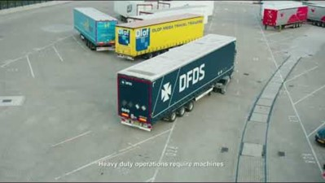
Pilot description: Use Case 4
Trailer transfer operations and automated ship loading in port. Demonstration of an autonomous trailer on a busy roll-in/roll-off terminal in Rotterdam Port (The Netherlands).
Port situations simulation in test track
9 scenarios tested (passable objects, vehicle overtaken, roundabout, etc.)
Different obstacles: car, pedestrian, barriers, pallets
Simulation of rain until 100mm/h
AWARD © - H2020 - Confidential, 2023
This project has received funding from the European Union’s Horizon 2020 research and innovation programme under Grant Agreement No. 101006817. The content of this presentation reflects only the author’s view. Neither the European Commission nor the INEA is responsible for any use that may be made of the information it contains.

Slide 10
Sustainability aspects of AWARD
The new fleet management system will allow to:
obtain a more efficient and reliable fleet
decrease handling times
decrease emissions
decrease need for human interaction
increase reliability and safety
AWARD © - H2020 - Confidential, 2023
This project has received funding from the European Union’s Horizon 2020 research and innovation programme under Grant Agreement No. 101006817. The content of this presentation reflects only the author’s view. Neither the European Commission nor the INEA is responsible for any use that may be made of the information it contains.

Slide 11
21/03/2024
Thank you!
See you in Brussels on
13 June 2024!
flavia.desimone@enide.com
AWARD has received funding from the European Union’s Horizon 2020 research and innovation program under Grant Agreement No 101006817.
The content of this presentation reflects only the author’s view. Neither the European Commission nor the INEA is responsible for any use that may be made of the information it contains.

